Slide 1

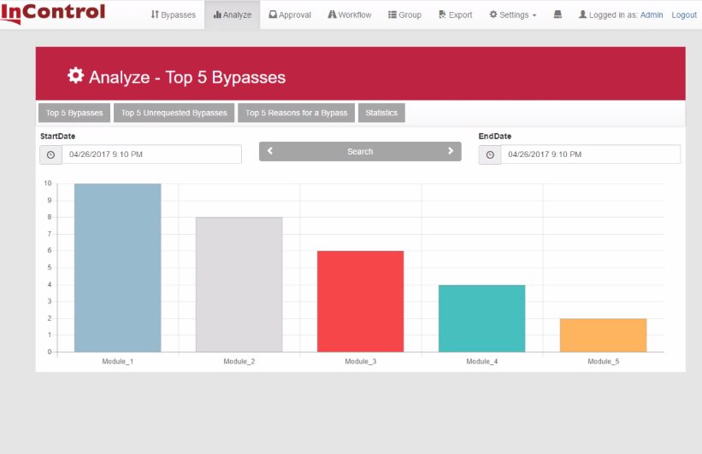




1) InControl User interface
Minimum supported browsers:
Internet Explorer v11
Chrome v54
Firefox v52
Level 4-5:
Business
Email
server
Firewall
Real Time Data
Port : 29080 (aanpasbaar)
Web service
Port: 80
2) InControl Software
Minimum Hard/Software Requirements:
Windows Vista /Windows Server 2008 / Windows 7 Embedded
CPU: 2Ghz / 32bit
RAM: 2GB
HDD: 1GB vrije ruimte
Installation options:
Virtual (OVA or VMDK) (= preconfigured SQL+Web)
or/and
Integration with existing infrastructure
or/and
New physical hardware
2
2.2
2.1
Web
services
Data
service
Web
host
Data Service
DMZ
Terminal
Services
2.1) InControl Web host
Web based access supported ( HTML5)
2.2) InControl Data Service
Installation Requirements:
SQL Server 2008 or higher
Virtual
Infrastructure
Firewall
Protocol: TCP/IP
Port: Default 29081 (Configurable)
Level 3:
Manufacturing
3) InControl OPC Monitor
Installation Requirements:
Stand alone executable or Installed service
DCS Administrator rights required
Running DCS OPC server
Licensed OPC tags
3
Engineering
Station
Application
Station
Level 2:
DCS
Operator
Stations

Slide 2
1) InControl User interface
Minimum supported browsers:
Internet Explorer v11
Chrome v54
Firefox v52
Level 4-5:
Business
Email
server
Firewall
Real Time Data
Port : 29080 (aanpasbaar)
Web service
Port: 80
2) InControl Software
Minimum Hard/Software Requirements:
Windows Vista /Windows Server 2008 / Windows 7 Embedded
CPU: 2Ghz / 32bit
RAM: 2GB
HDD: 1GB vrije ruimte
Installation options:
Virtual (OVA or VMDK) (= preconfigured SQL+Web)
or/and
Integration with existing infrastructure
or/and
New physical hardware
2
2.2
2.1
Web
services
Data
service
Web
host
Data Service
DMZ
Terminal
Services
2.1) InControl Web host
Web based access supported ( HTML5)
2.2) InControl Data Service
Installation Requirements:
SQL Server 2008 or higher
Virtual
Infrastructure
Firewall
Protocol: TCP/IP
Port: Default 29081 (Configurable)
Level 3:
Manufacturing
3) InControl OPC Monitor
Installation Requirements:
Stand alone executable or Installed service
DCS Administrator rights required
Running DCS OPC server
Licensed OPC tags
3
Engineering
Station
Application
Station
Level 2:
DCS
Operator
Stations

